Slide 1
Disease Diagnosis System by Exploring Machine Learning Algorithms
Final Year project presented by:
Allen Daniel Sunny 1NT14CS015
Sajal Kulshreshtha 1nt14cs136
Satyam Singh 1nt14cs141
Srinabh 1nt14cs60
Guide:
MR. Mohan ba
Associate professor
Dept. of cse
Nmit, bangalore-560064

Slide 2
Introduction
Machine learning is one of the key methods used in modern day analysis.
Machine learning uses various algorithms in order to process the vast amount of data that is generated. These algorithms are usually developed from a statistics perspective, and have only recently been co-opted by machine learning.
Machine learning algorithms are broadly classified in four types, Supervised learning, Unsupervised Learning, Semi-supervised Learning and Reinforcement Learning

Slide 3
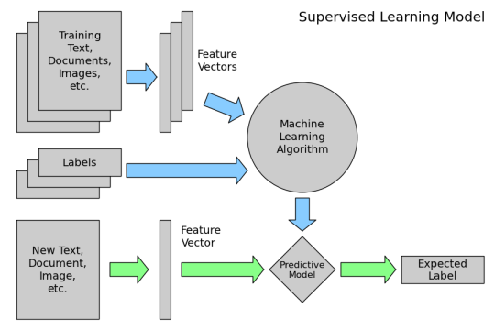
Architecture model

Slide 4
Training Text – The training information is part of the data preprocessing
Feature vectors – A feature vector is an N-dimensional vector of numeric type , that is used to represent a certain object.
Labels – Labels typically take a set of unlabeled data and then assigns a particular class or label that data. Labelled data now has some underlying meaning and can be more easily processed by the algorithm.
Predictive model- A predictive model is a model that is generated from the given train set. The predictive model is then compared with the actual model , with parameters such as accuracy then generated.

Slide 5
Data Preprocessing is one of the major parts of the data analytics. For every analysis, data needs to be cleaned , fitted and transformed.
The diagram below represents a pictorial representation of the given process.

Slide 6
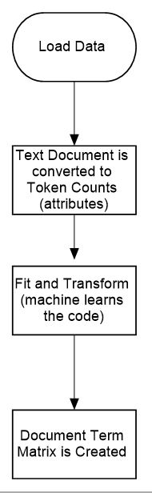

Slide 7
From the above diagram , we can observe the steps required in order to pre process data from text to tokens.
Taking implementation of the above flowdiagram

Slide 8

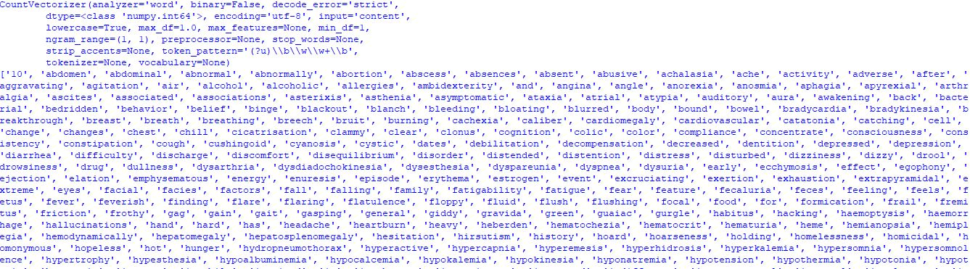
TOKENIZATION
Output:

Slide 9
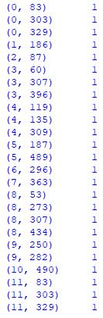
TRANSFORMATION
OUTPUT

Slide 10
Machine learning algorithms – These are the various algorithms used in the analysis of the data. In this project.
Some of the various machine learning algorithms we have explored here are –

Slide 11
Overview of algorithms used
Naïve Bayes Algorithm-
Naïve Bayes classifiers are a family of classifiers that are based on the application of the Bayes theorem with a strong emphasis on the independence of the various features.
They are highly scalable , requiring multiple vectors in order to generate an optimum output
It is highly useful in the processing of very large data sets
Bayes theorem identifies a way to calculate the below equation for a posterior probability P(c|x)

Slide 12
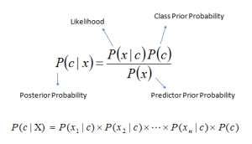

Slide 13
Logistical Regression –
It is a statistical method of analyzing a data set that assumes that there are one or more independent variables , and the final output is measured by a dichotomous variable, from which there are only two outputs.
he goal of logistic regression is to find the best fitting (yet biologically reasonable) model to describe the relationship between the dichotomous characteristic of interest (dependent variable = response or outcome variable) and a set of independent (predictor or explanatory) variables

Slide 14


Slide 15
KNN Algorithm-
In pattern recognition, the k-nearest neighbors algorithm (k-NN) is a non-parametric method used for classification and regression. In both cases, the input consists of the k closest training examples in the feature space. The output depends on whether k-NN is used for classification or regression:
In the classification phase, k is a user-defined constant, and an unlabeled vector (a query or test point) is classified by assigning the label which is most frequent among the k training samples nearest to that query point.

Slide 16
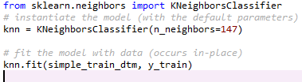
Importing the KNN function and fitting the trained data

Slide 17

Here we have transformed the given test data

Slide 18
Here we have transformed the given data and the outputted the same

Slide 19

Importing the CountVectoriser, and fitting the value

Slide 20
Decision Trees –
Decision Trees are a type of Supervised Machine Learning (that is you explain what the input is and what the corresponding output is in the training data) where the data is continuously split according to a certain parameter. The tree can be explained by two entities, namely decision nodes and leaves. The leaves are the decisions or the final outcomes. And the decision nodes are where the data is split.

Slide 21
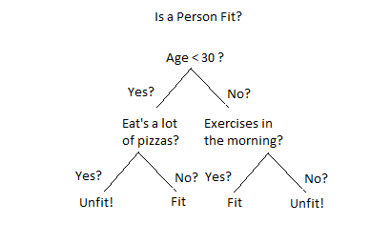

Slide 22
From the above tree we can observe the general model of a decision tree
There are two main types of Decision Trees:
Classification trees (Yes/No types)
What we’ve seen above is an example of classification tree, where the outcome was a variable like ‘fit’ or ‘unfit’. Here the decision variable is Categorical.
Regression trees (Continuous data types)
Here the decision or the outcome variable is Continuous, e.g. a number like 123.

Slide 23
Results
Given below are the various screenshots of the code implementation with the various algorithms

Slide 24
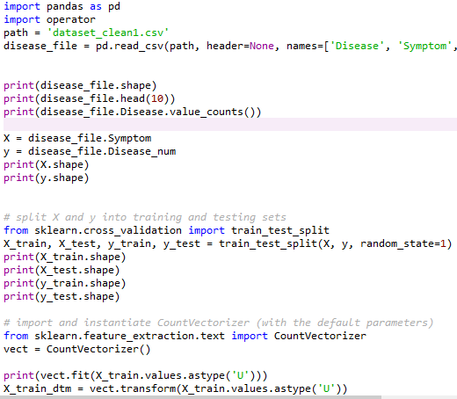
KNN Algorithm

Slide 25
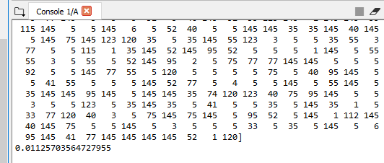

Slide 26
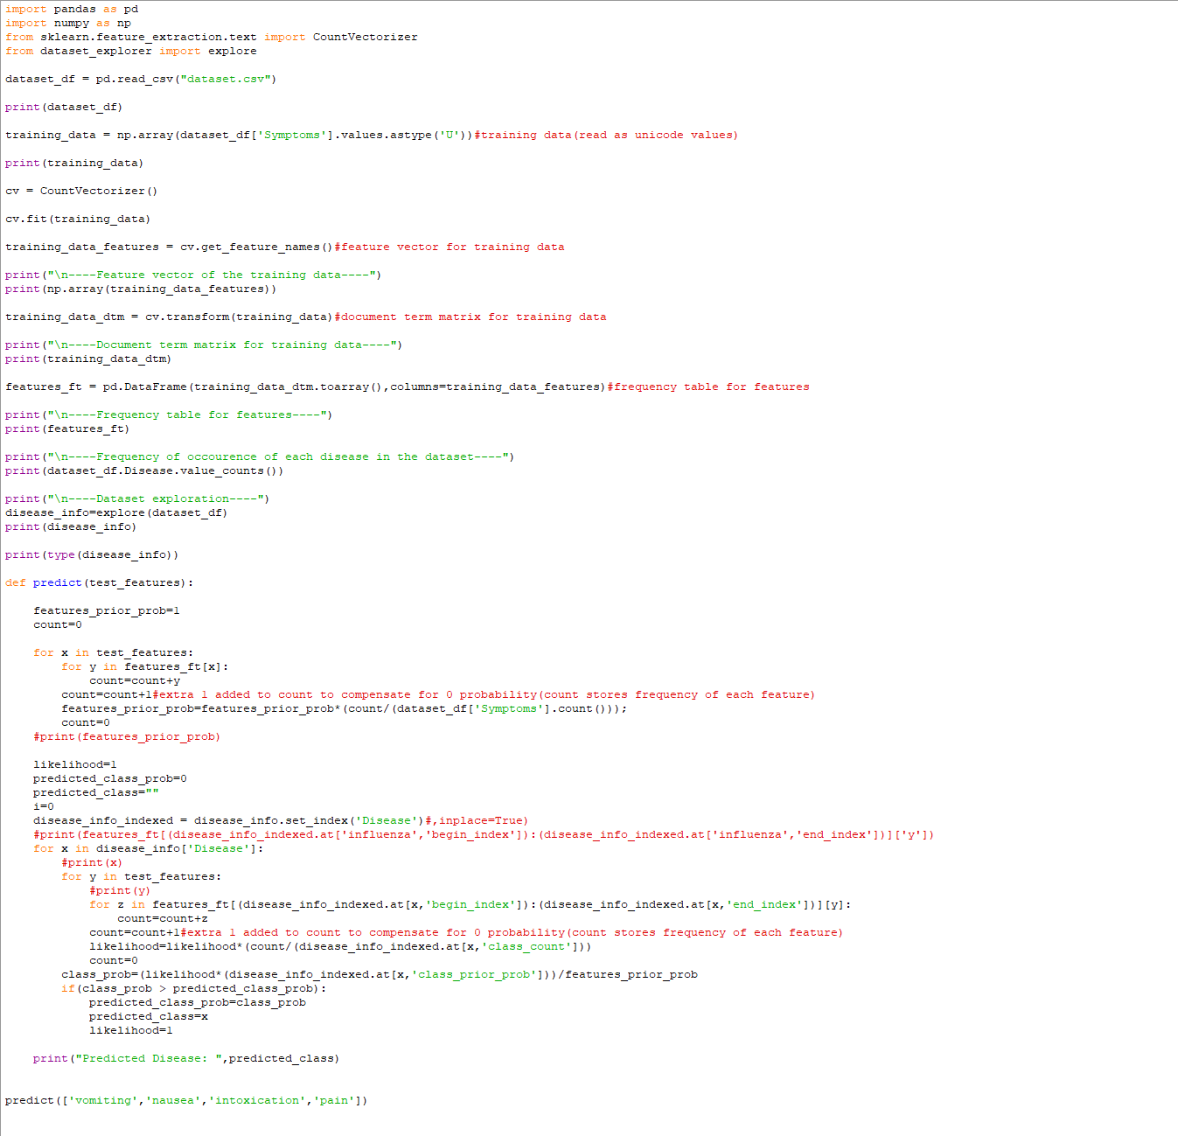
Naïve Bayes C

Slide 27
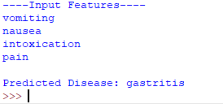
Naïve Bayes (Output)

Slide 28
THANK YOU

